Slide 1

GoBeyondClassroom

Slide 2
Meet The Outstanding Team
Project advisor
Dr. Brian T. Bennett
Developers
Neel Patel
Udaynath Yerramsetty
Pragna Sai Nutulapati

Slide 3
The Problem!
Lack of communication between the departments and the community
One department need assistance, but it is difficult to find correct person/s or student/s
Time consuming and inefficient

Slide 4
The Idea!
A platform to connect all students and community partners
Community partners can propose their project ideas
Students who have similar skills can apply to work on a particular project
Reduces the communication gap
Less time consuming and more efficient

Slide 5
User Roles
Administrator
Client/Community Partner
Student
Faculty

Slide 6
Administrator
Approve or reject user requests
Admin will have rights to approve or reject the proposed project requests if necessary
Admin will have rights to manage users

Slide 7
Client/Community Partner
Propose projects
Approve or reject requests from students to work on project
Approve or reject requests from faculty to work on project
Keep project track record

Slide 8
Student
Apply for a proposed project with similar skills
Result: Work on project if approved by the client/community partner
Goal: Improve skills by working on the projects

Slide 9
Faculty
Apply for a proposed project with similar skills
Result: Work on project if approved by the client/community partner
Goal: Guide students on project and increase community service

Slide 10
Tools and technologies
Angular
Docker
Spring boot
Visual Studio Code
GitHub
Postman/Insomnia
Framer
Swagger UI

Slide 11



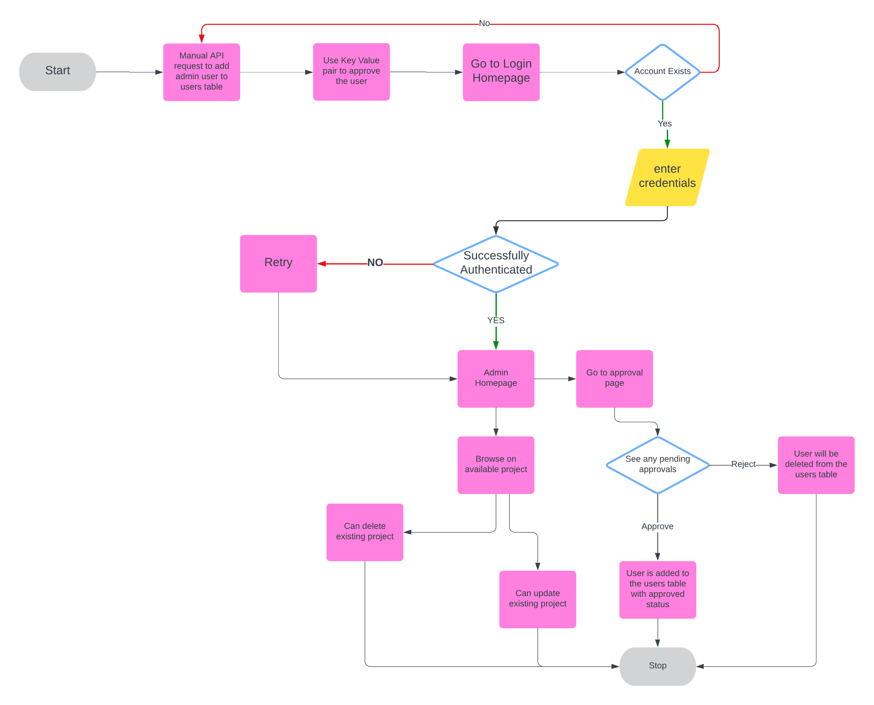
Admin Demo

Slide 12
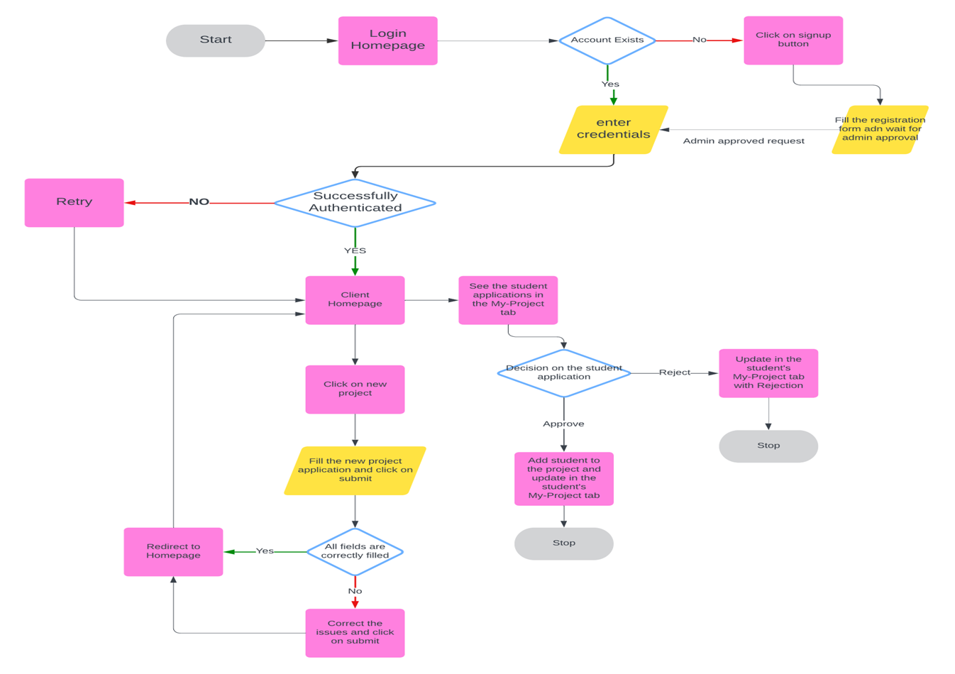
Client Demo

Slide 13
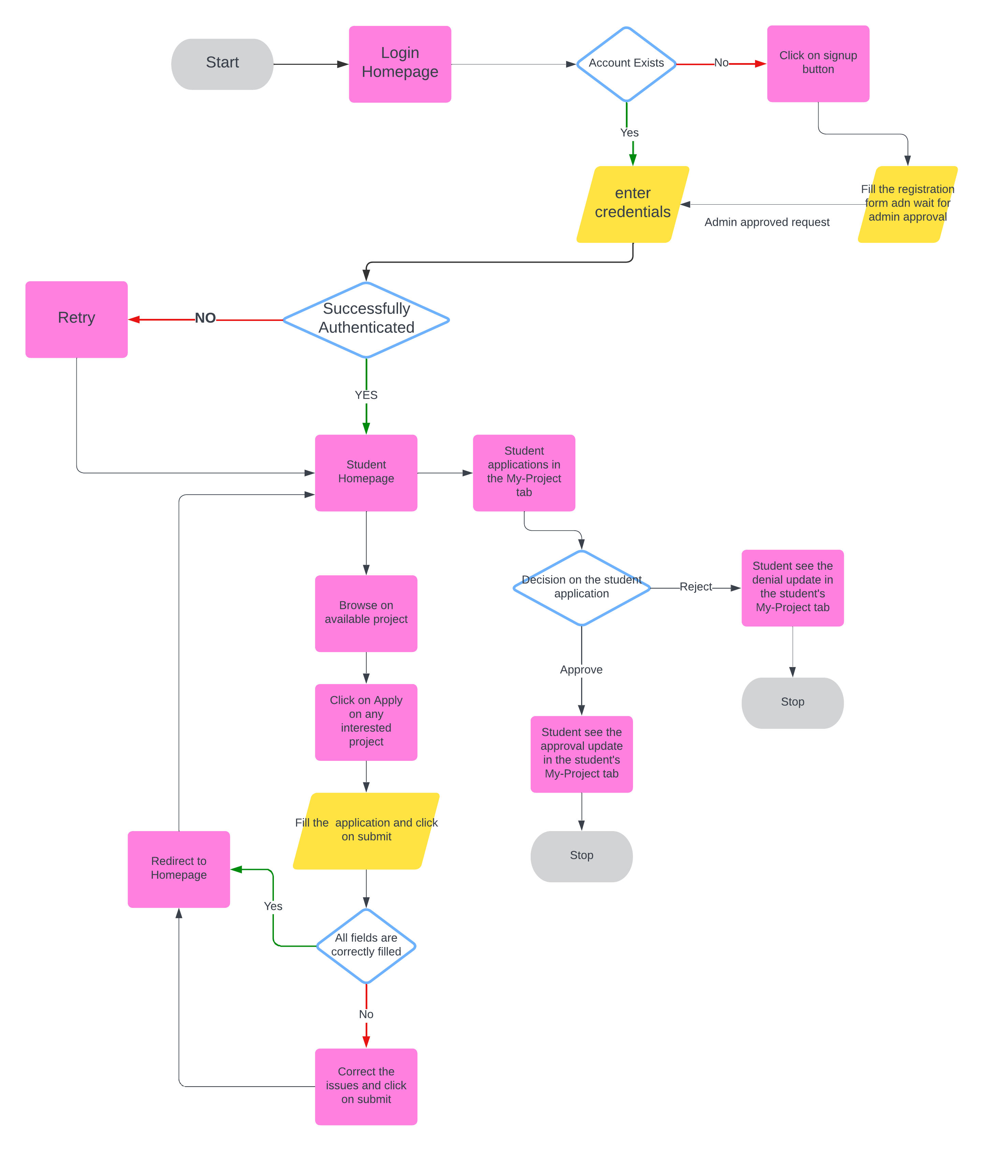
Student/Faculty Demo

Slide 14
Challenges faced
Challenge-1:
Usage of JPA Annotations: Utilized annotations such as @ManyToMany and @OneToMany for establishing relationships between multiple database tables.
Circular Dependencies: These annotations led to circular dependencies within the objects. Circular dependencies occur when two or more classes depend on each other either directly or indirectly, creating a cycle that can lead to issues.
Project Impact: The circular dependencies ultimately caused build failures, disrupting the project development process.
Solution:
Direct ID Referencing: Opted to establish relationships manually by using the primary IDs of each table for referencing instead of relying on JPA's automatic relationship handling.
Benefits Achieved:
Mitigated Circular Dependencies: This approach successfully prevented the formation of circular dependencies.
Avoided Build Failures: By eliminating these dependencies, the project builds successfully without errors related to entity relationships.
By manually mapping relationships using table IDs, the knowledge gained through the data management class helped explicit control over how entities relate to each other, thereby avoiding automatic resolution mechanisms that might create circular dependencies.

Slide 15
Challenges faced cont..
Challenge-2:
Large Request Payloads: Initial fetching of entire project details caused performance issues.
Complex Data Retrieval: Led to increased server load and slow response times.
Solution:
Data Segregation: Created a "Project Applications" table to streamline data handling.
One-Way Bindings: Used project IDs for references, reducing data redundancy.
Benefits Achieved:
Optimized Request Payloads: Reduced data transfer for faster responses.
Improved Performance and Scalability: Enhanced system scalability and user experience.

Slide 16
Challenges faced cont..
Challenges-3:
Base Image Selection: Needed a base image that supports both building the project with Maven and deploying it to a Tomcat server.
Solution:
Multi-Stage Docker Build:
First Stage: Selected a base image with essential tools like Maven for building the project.
Second Stage: Switched to a Java base image for deploying the application on Tomcat.
Benefits Achieved:
Efficient Docker Images: Ensured the final Docker image contained only necessary dependencies, reducing size and improving security.
Optimized Build and Deployment: Streamlined the process for both building and deploying the Spring Boot application within Docker.
The software production course provided a foundational understanding of best practices in coding, version control, and deployment, significantly enhancing our ability to develop robust and maintainable software. Course also provided essential insights into Docker and containerization, teaching us how to effectively containerize applications for better scalability and portability.

Slide 17
Challenges faced cont..
Challenge - 4:
CORS Restrictions: Frontend requests were blocked by the backend due to origin differences, resulting in "Cross-Origin Request Blocked" errors.
Solution:
Backend Configuration:
Spring Boot CORS Setup: Configured CORS in the backend using Spring Boot, defining a CorsFilter bean to allow requests from any origin, method, and headers.
Frontend Adjustments:
Proxy Configuration: Set up a proxy (e.g., "proxy.conf.json" in Angular) to forward requests to the backend API, effectively bypassing CORS restrictions.
Benefits Achieved:
Seamless Communication: Enabled smooth cross-origin communication between the frontend and backend, eliminating CORS issues.
Enhanced Development Experience: Simplified development and testing processes by resolving cross-origin errors.
Software validation and verification course enhanced our ability to anticipate and resolve integration issues like CORS by teaching systematic debugging and testing principles. This ensured correct CORS configurations and seamless frontend-backend communication in our project.

Slide 18
Learning Implemented
Requirements gathering
Paper Prototype
Design and implementation
Testing
GitHub
Docker and containerization
Sprint

Slide 19
Question?

Slide 20
Thank you!

